Slide 1
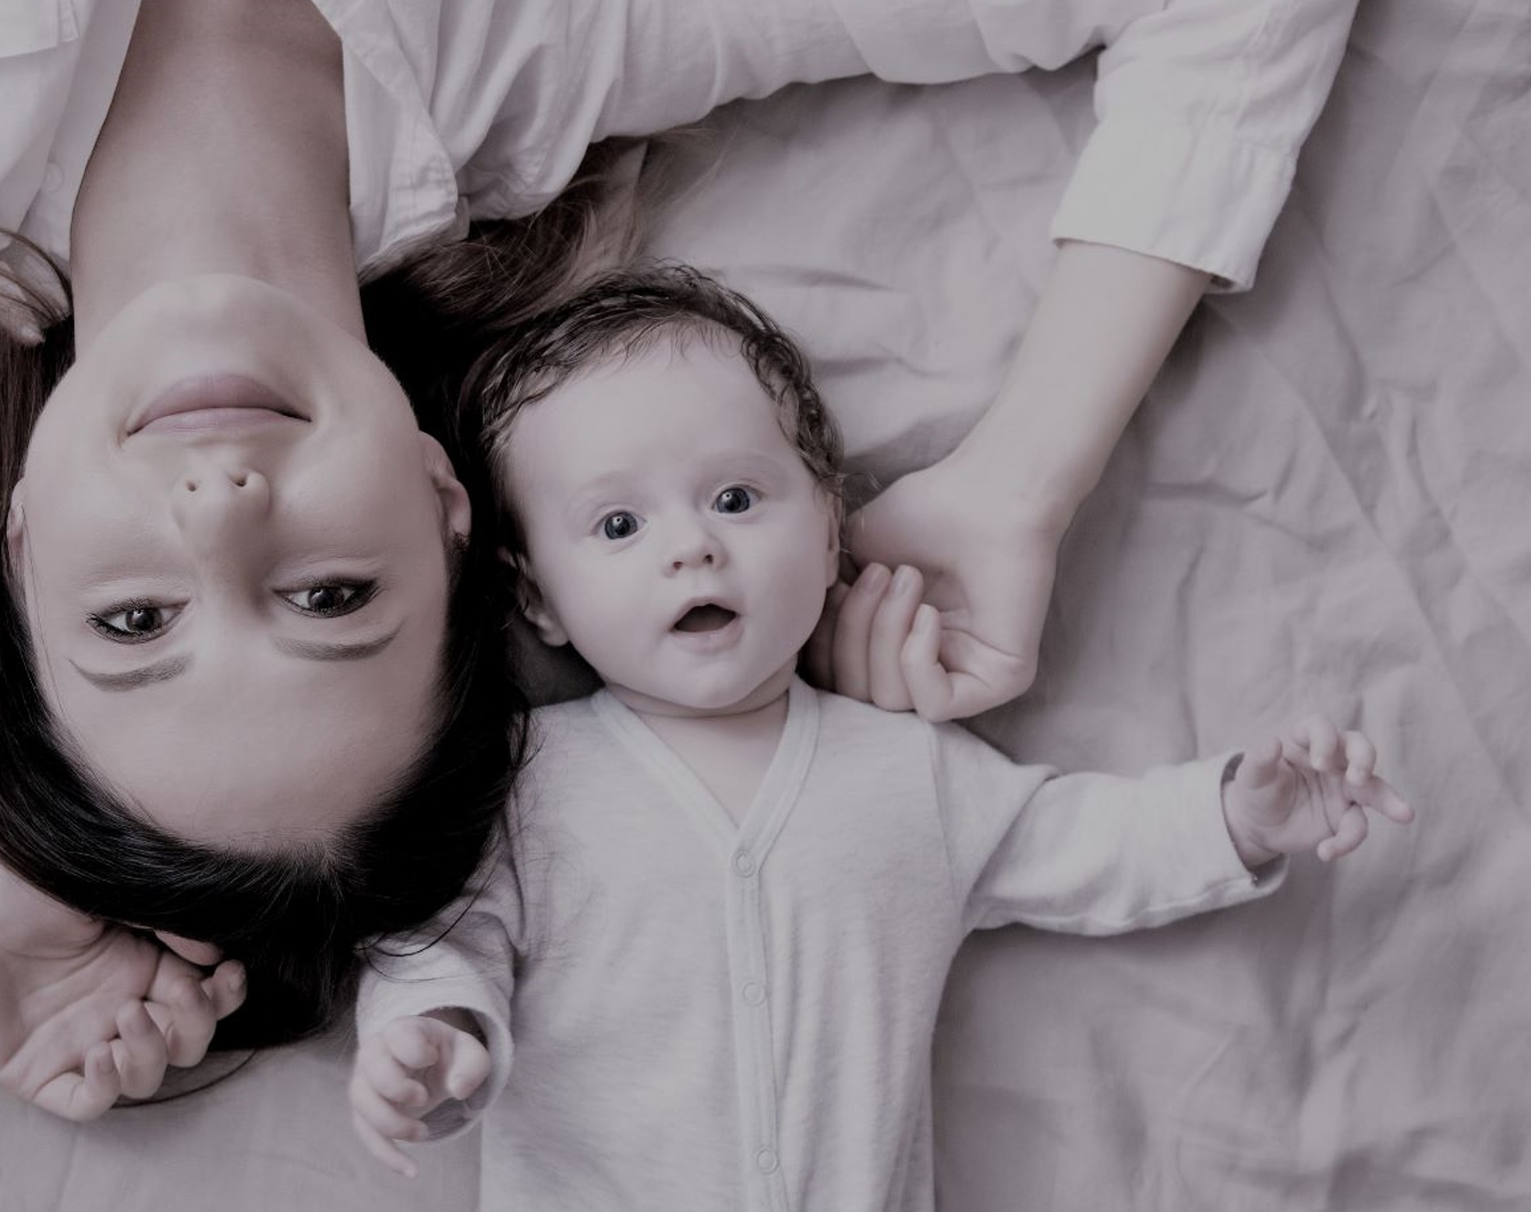
Special Trusts for Special People, Part 1
Catherine Swiniarski Elder Law of Omaha

Slide 2
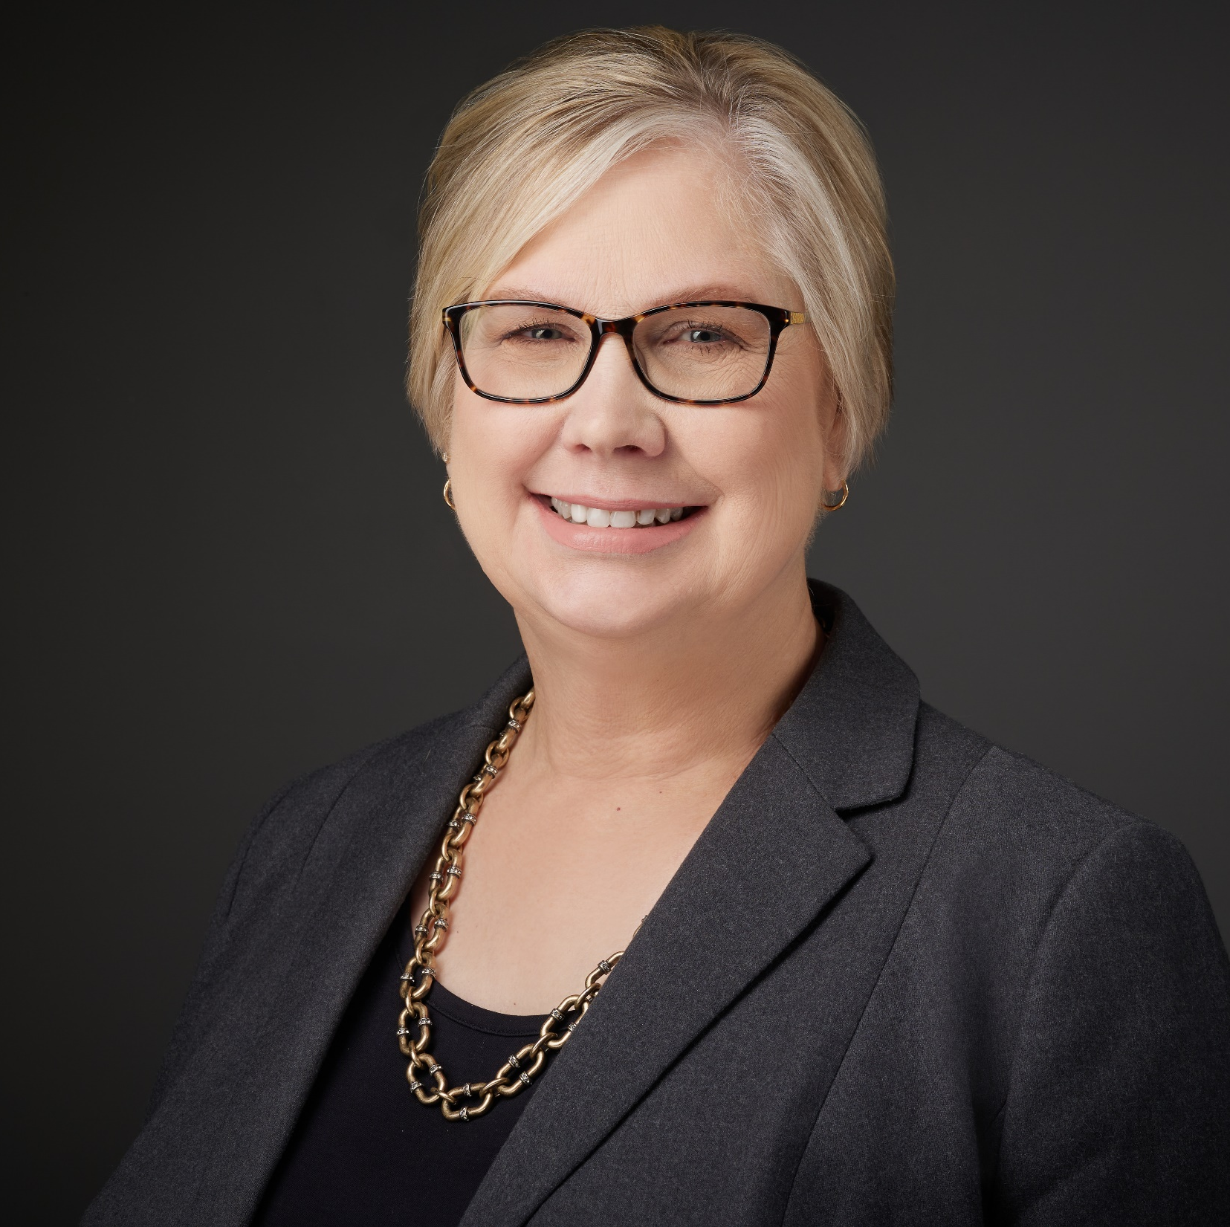
ELDER LAW OF OMAHA Catherine N. Swiniarski
Graduated from Creighton University School of Law in 1986
Member of the Nebraska & Iowa Bar Associations
Member of the Elder Counsel and National Academy of Elder Law Attorneys

Slide 3
WHAT IS A SPECIAL NEEDS TRUST?
A grantor (sometimes called a “Settlor” or “Trustor”) is the person who establishes the trust and generally the person whose assets fund the trust.
First Party or Self-Settled Special Needs Trust is established by the Beneficiary (often through a Guardian, Legal Representative, or Court) and funded with the Beneficiary’s own money. The trust property is subject to Medicaid recovery after death.
For example, proceeds from a lawsuit.
Third Party Special Needs Trust is established by someone other than the individual with special needs, usually by a parent or guardian, grandparent, sibling, or other family member with funds that do NOT belong to the beneficiary. The trust property is NOT subject to Medicaid recovery after death.
For example, proceeds from life insurance or inheritance.
To determine First Party or Third Party, ask:
Did the beneficiary have the right to outright possession of the proceeds prior to the act establishing the trust?

Slide 4
A “Supplemental” Needs Trust that holds title to property for the benefit of by a child or adult with special needs.
Intended to retain or obtain eligibility for public benefits.
“Supplements” public benefits received by an individual with special needs, to improve their quality of life by providing amenities beyond their basic needs.

Slide 5
KEY DISTINCTIONS OF SPECIAL NEEDS TRUSTS
The beneficiary, the person for whose benefit the trust is established, will usually be disabled or incapacitated.

Slide 6
KEY DISTINCTIONS OF SPECIAL NEEDS TRUSTS
“Disability” generally refers to the standard used to determine eligibility for Social Security Disability Insurance (SSDI) or Supplemental Social Security Income (SSI) benefits: the inability to perform any substantial gainful employment.

Slide 7
KEY DISTINCTIONS OF SPECIAL NEEDS TRUSTS
“Incapacity” generally refers to mental limitations. Not every disability will result in a finding of incapacity. It is possible for a special needs beneficiary to be disabled and not mentally incapacitated.

Slide 8
KEY DISTINCTIONS OF SPECIAL NEEDS TRUSTS
Irrevocable Trust – Special Needs Trusts are generally irrevocable, meaning permanent or irreversible; cannot be cancelled or amended.

Slide 9
KEY DISTINCTIONS OF SPECIAL NEEDS TRUSTS
Restrictions on use of distributions from trust and allocation of funds after death of beneficiary.

Slide 10
HOW DO SPECIAL NEEDS TRUSTS AFFECT PUBLIC BENEFITS?
Third party trusts (trusts created by a will or by a parent, grandparent, or guardian with money that is NOT the money of the special needs person) will not cause Medicaid or SSI ineligibility, if properly spent on allowable goods or services. On the passing of the beneficiary, the money left in trust goes to the beneficiary’s heirs.

Slide 11
HOW DO SPECIAL NEEDS TRUSTS AFFECT PUBLIC BENEFITS?
First party trusts (trusts created with the beneficiary’s own money, for example, a personal injury settlement), must be more carefully spent, and money left goes back to Medicaid for estate recovery.

Slide 12
ADVANTAGES AND DISADVANTAGES OF SPECIAL NEEDS TRUSTS
Advantages – allows a beneficiary to have more discretionary funds and not be over resources for public benefit programs. Also allows a trustee to control assets of a special needs person who may have limited capacity to deal with money.
Disadvantages – money in trust can only be spent on a limited range of goods and services, careful accountings must be kept, and the beneficiary has very limited access to the funds.

Slide 13
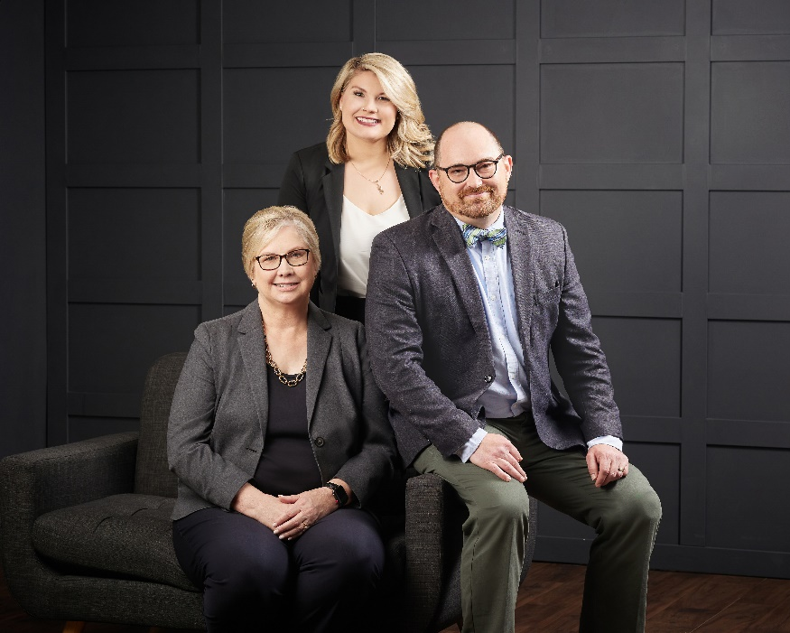
CATHERINE N. SWINIARSKI, J.D.
Managing Attorney and Owner
LICENSED IN NEBRASKA & IOWA
NICK HALBUR, J.D.
Senior Attorney
LICENSED IN NEBRASKA & IOWA
SAMANTHA S. D’ANGELO, J.D.
Associate Attorney
LICENSED IN NEBRASKA

