Slide 1
Division of Developmental Disabilities
Amy Nutter, Service District Administrator District 1
Kelly Mand, Service Coordinator Supervisor
Tricia Stone, Service Coordinator Supervisor
August 30, 2016

Slide 2
Governor’s Priorities
A more efficient and effective state government
A more customer-focused state government
Grow Nebraska
Improve public safety
Reduce regulation and regulatory complexity

Slide 3
DHHS Accomplishments
SNAP timeliness in processing applications improved to 99.28 percent on time for October 2015- March 2016. Due to the improved performance, Nebraska is no longer on the list to potentially lose federal funds.
Nebraska’s most recent ranking in processing SNAP applications improved from 50th of 53 one year ago to 23rd.
As of August 1st, Alternative Response is being used in 57 counties.
Nebraska Pre-Admission Screening & Resident Review (PASRR) Program improved turnaround time from seven days to less than three days.
DHHS Business Plan released with 25 initiatives to improve services and deliver better results.
Division of Public Health achieved national accreditation.
Division of Behavioral Health implemented COMPASS data management platform on May 16 to support its new Centralized Data System.
All eight DHHS Legislative bills passed to provide more effective state government and improve supports for our most vulnerable citizens.
Six of seven federal child welfare standards exceeded.
ACCESSNebraska average call wait times for Economic Assistance and Medicaid in 2016 average below 5 minutes
ACCESSNebraska improves services to participants by taking applications over the phone, and sending emails about participant communications to expedite services and benefits.
Grand Island Veterans’ Home earned 2016 Bronze National Commitment to Quality Award.
Nurse licensing improvements – simplified license applications, streamlined screening, and faster tutorial time.

Slide 4
Looking Ahead – DHHS Priorities
Heritage Health Medicaid Managed Care to integrate physical and behavioral health care and pharmacy services effective Jan. 2017
System of Care for children and youth with a serious emotional disturbance, and their parents, through partnerships with public and private agencies, families and youth.
Behavioral health supported employment and housing as key supports to recovery.
Long-Term Services and Supports Redesign.
Renewal of Medicaid adult waivers and one children’s waiver for people with developmental disabilities
Coordinated efforts of Behavioral Health, Public Health, and Medicaid and Long-Term Care to combat opioid addiction and over prescribing of opioids.
Reduction in out-of-home placements for state wards.
Improved DD application and eligibility determination processes.
Medicaid Management Information System (MMIS) replacement planning process.
Prescription Drug Overdose Prevention – $3.5 million in federal grants to help reduce misuse and abuse of prescription drugs. DHHS Divisions of Public Health, Behavioral Health and Medicaid and Long-Term Care collaborating to address the issue.

Slide 5
Division of Developmental Disabilities
Responsibilities of the Division of Developmental Disabilities Services (DDD)
DDD is responsible for the delivery of services in Nebraska for individuals with a developmental disability, including intellectual disabilities.
DDD is responsible to maximize federal funding whenever possible. Home and Community Based Services (HCBS) waivers for individuals with developmental disabilities require individuals to meet the ICF level of care requirement to received HCBS waiver funding.
DDD offers community-based services as well as state-operated services in the service array.
DDD services are person-centered services based on a person wants (important to) and needs (important for).

Slide 6
Division of Developmental Disabilities
DDD administers five separate programs today:
Three Medicaid waivers – Two State Directed Services-
Children’s Waiver, Developmental Disabilities Services Act (DDSA),
Adult Comprehensive Waiver, Developmental Disabilities Custody Act (DDCA)
Adult Day Waiver
By September 30, 2016 the State of Nebraska will submit two waivers for renewal to the Centers for Medicare and Medicaid Services (CMS) for review and approval. We will submit a lifespan Comprehensive Waiver and an Adult Day Waiver. We are projecting the waiver changes to be approved and effective January 1, 2017.

Slide 7
Goals of DDD
To offer accurate and timely eligibility determinations.
To utilize the funding allocated by the Legislature and maximize the federal funding available by the Centers of Medicare and Medicaid Services (CMS) to serve as many individuals as possible while ensuring the health & safety of those we do serve.
To be person-centered in the delivery of services. We want to focus to what is important for the individual as well as important to the individual.
To ensure the individuals experience quality of life and that services are available to support what is meaningful to them.
To reach out to our divisional partners to ensure that we are maximizing our resources to benefit of everyone involved, the individual, the providers, the community, advocates and general public.
Questions or comments?

Slide 8
Application Process
Applying for services from the Division of Developmental Disabilities
Apply online via ACCESSNebraska at: www. ACCESSNebraska.ne.gov
Apply at any local DHHS office
An application can be made by the individual, guardian or legal representative.
The application has been redesigned by a stakeholder group which consists of individuals with developmental disabilities, parents, guardians, advocates such as representatives from PTI Nebraska and many others through their comments and sharing their stories with us.
The application is simple. The application contains a release of information which allows DDD to contact identified professionals in the areas of medicine and education to obtain those records electronically which shortens the timeframe for an eligibility determination to occur. Developmental Disability Specialists can reach out to individuals and their guardians to obtain additional information quickly. Our processing time on applications has decreased dramatically over the last few months. This is an area of operational excellence for our Division and we will continue to identify areas of improvement.

Slide 9
Initial Eligibility
The eligibility requirements for services administered by the Division of Developmental Disabilities include:
Citizenship or legal resident of US.
Legal resident of the State of Nebraska.
A Developmental disability as defined in Neb. Rev. Stat. § 83-1205.
LB1039, signed into law in 2016, updates the definition of DD to ensure consistency among the DD programs and Medicaid requirements.
DD Services are voluntary.
Educational Services are an entitlement.
Anyone can submit an application for eligibility determination.

Slide 10
Barriers to Initial Eligibility
Lack of documentation causing a delay in or inability to make a decision:
No school records;
No psychological report(s)
No Medical Documentation of DD ( genetic reports or affirmation of DD)
No adaptive assessments
No diagnosis of ID
Records not available – (school records destroyed, doctors moved or retired, person from outside U.S. )
Submission of irrelevant documentation and pure volume of records (dental records, well child checks, chiropractic records, i.e.)
Resistance to completing assessment(s)
Sending consent forms etc. via secure mail (recipients have difficulty opening DHHS secure mail – then a second form needs to be sent by U.S. mail.)
Lack of response by the Applicant causing a delay in making a decision:
Unsigned required forms
Language barriers
No contact from applicant – after DDD has attempted to reach
No understanding of or the lack of ability to gather the required documentation

Slide 11
Barriers to Initial Eligibility Continued…
Misunderstanding by applicant of DD Services. The applicant believes that they are applying for:
SSI benefits
Medicaid
Financial assistance
Crisis services
Behavioral health services
Day care or respite services
Medicaid Aged & Disabled Waiver services
Housing assistance

Slide 12
Not DD Eligible:
Notice of Decision (NOD) sent to individual or their guardian.
If an individual is determined “Not Eligible” they have the following rights:
Due process rights and Request for Informal Dispute Resolution (IDR) and/or Appeal hearing attached to NOD
90 days to request an IDR and/or appeal hearing
All requests are reviewed by a Community Coordination Specialist or a supervisor to ensure compliance with regulations, policies and operational guidelines.
Community-Based Services Deputy Director or designee review IDR information to affirm or reserve original decision.
DD attorney represents DDD at appeal hearings
Hearing officer presents record to DDD Director Courtney Miller
for affirmation or reversal of original decision.

Slide 13
DD Eligible:
After an individual is determined eligible:
Notice of Decision (NOD) sent to individual or guardian
Designated Service Coordination staff contact applicant and determine what services are needed
Individuals are then placed on the registry of unmet needs with the date of need (the date they are found eligible)

Slide 14
Registry of Unmet Need
Services are offered based on who has been on the registry of unmet needs the longest unless the individual meets “priority one” funding.
All other funding offers occur when funding is appropriated from the Legislature.
If individual is over age 21 and has graduated from a high school on or after September 6, 1993, day services are automatically funded according to § 83-1216.
Services not available until end of school year in which they turn 21.
Division cannot pay for (supplant) services that are available from the educational system.

Slide 15
Funding prioritization as outlined by statute and regulations:
83-1202. Legislative Intent: The first priority of the State in responding to the needs of persons with developmental disabilities should be to ensure that all such persons have sufficient food, housing, clothing, medical care, protection from abuse or neglect, and protection from harm;
404 NAC 3-002.02 Funding Prioritization: As funding is available, the Department will authorize funding of specialized services for individuals who meet priority criteria. Priority is given to:
Individuals who need immediate intervention to prevent imminent physical harm caused by:
a. Abuse or neglect;
b. Lack of medical care;
c. Lack of food, housing or clothing; or
2. Individuals for whom immediate intervention by the Department is
needed to prevent harm to themselves or others; or
3. All other eligible individuals waiting the longest.

Slide 16
Objective Assessment Process (OAP)
DD utilizes an OAP process to determine a participant’s funding amount
Once funding is offered and accepted, Inventory for Client and Agency Planning (ICAP) is administered.
Needs revealed in the ICAP translate into Individual Budgeted Amount (IBA) which is an annual budget amount for participants to choose services that meet their goals and preferences.

Slide 17
What is next?
Once IBA is determined, assigned Service Coordinator (SC) will meet with the individual/guardian to discuss service options available.
Proposed budget is developed to purchase services needed within the individual’s IBA.
Providers are selected based on individual’s/guardian’s choice
A team meeting is held to develop the Individualized Support Plan (ISP)

Slide 18
Role of a Service Coordination
Service Coordination is responsible for the delivery of targeted case management services.
This includes completing screenings and assessments to identify a person’s needs or what is important for them.
Complete a personal focus worksheet which identifies what is important to the individual.
Share the services available in the service array to ensure informed consent occurs when an individual or guardian (if one exists) select their services and their service provider.
Develops a plan that the individual designs with their team, including guardians and providers.
Assure adherence to the plan designed by the individual or guardian (if one exists) by collecting and analyzing data and monitoring through site visits.
Assists the individual in accessing other formal supports such as Medicaid, Social Security Benefits, etc.
Advocate for the individual by ensuring that their voice is heard and respected.

Slide 19
Services Funded through DDD include:
Habilitation is defined as the assistance provided to an individual with achieving developmental skills when impairments have caused delaying or blocking of initial acquisition of the skills. This can include cognitive, social, fine motor, gross motor or other skills that contribute to mobility, communication, and performance of activities of daily living (ADL) and enhance the quality of life.
Day Habilitation - These may include vocational planning, integrated community employment, workstation and day habilitation training and supports designed to assist in becoming employed. Services may range from teaching job skills prior to becoming employed, assisting in acquiring a job, and supporting a person in a community integrated job. Day Habilitation provide opportunities during the day that are focused on community inclusion and integration activities.
Residential Habilitation – these services may be provided in the individual’s home, the family home or at a provider operated home and include training and supports designed to assist the individual in acquiring independent living skills. Some examples include in-home services, companion homes, extended family home (EFH), and group homes.
Respite – services to provide occasional relief to a non-paid caregiver that lives with the
individual receiving services.

Slide 20
Helpful Resources…
Ready Set Go!
http://readysetgo.site.esu9.org/
Transition Booklet to Resources
http://dhhswebsiteauthoring/developmental_disabilities/Documents/DD-PUB-7.pdf
Home and Community Based Services Medicaid Waiver Initiatives
http://dhhs.ne.gov/medicaid/MedicaidWaiverInitiative/Pages/Home.aspx
PTI Nebraska
2564 Leavenworth St, Suite 202 Omaha, NE 68105 In the Alliance Group Building (402) 346-0525 (800) 284-8520 info@pti-nebraska.org

Slide 21
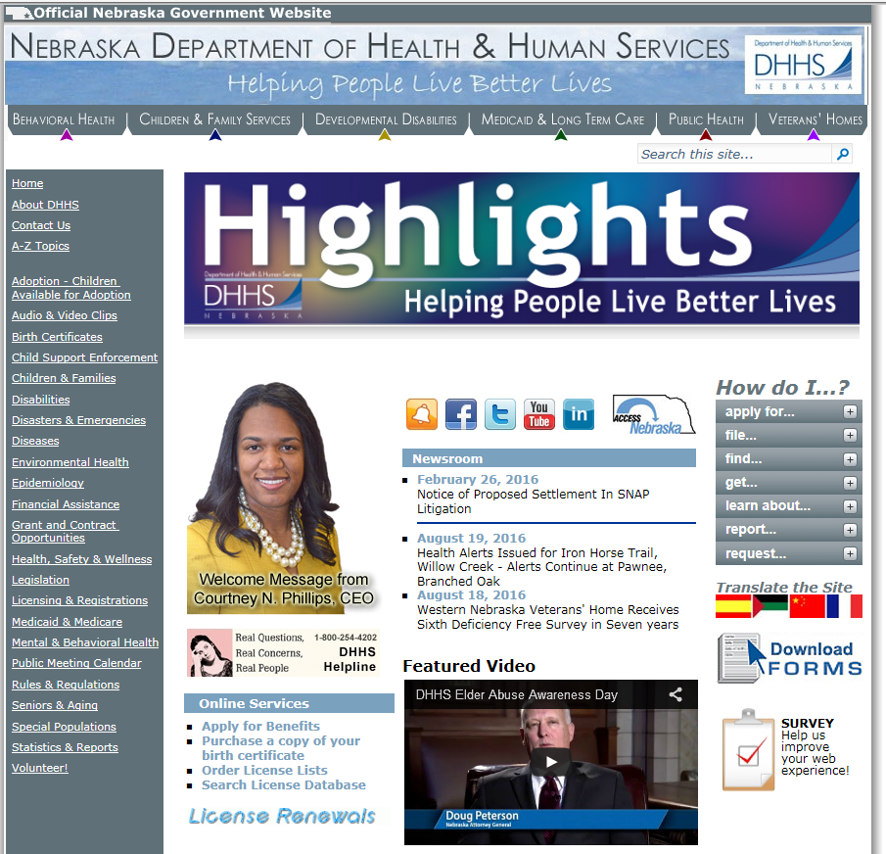
DHHS Website

Slide 22
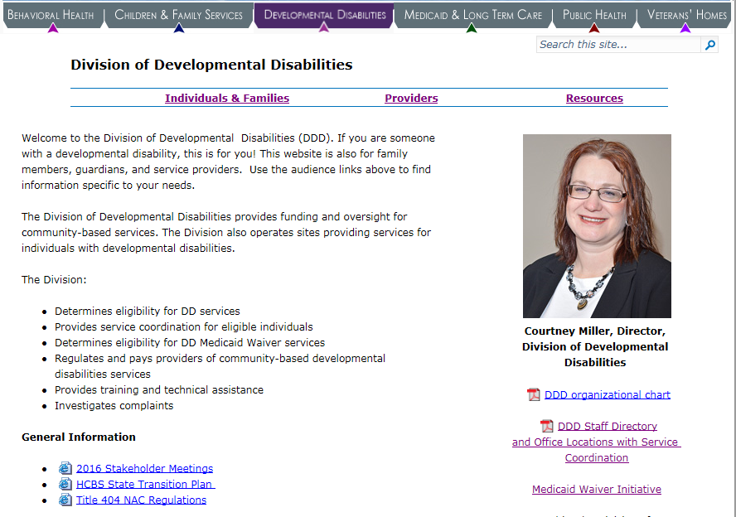
Developmental Disabilities Webpage

Slide 23
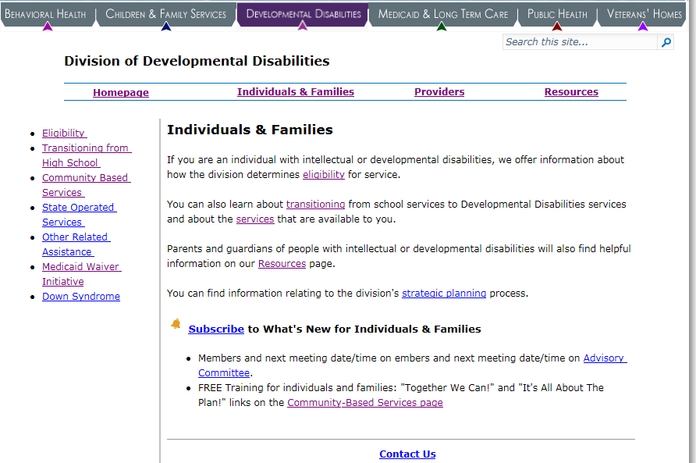
Individuals and Families Webpage

Slide 24
Questions?

Slide 25
Contacts
Courtney Miller, Director
Courtney.Miller@Nebraska.gov or 402-471-6038
Lori Harder, Deputy Director of Community Based Services
Lori.Harder@Nebraska.gov or 402-471-8714
Tony Green, Deputy Director of Policy and Communication
Tony.Green@Nebraska.gov
Megan Gumbel, Deputy Director of State Operated Facilities
Megan.Gumbel@Nebraska.gov or 402-223-6858
Angie Ludemann, Field Operations Administrator
Angie.Ludemann@Nebraska.gov or 402-471-8662

